Slide 1
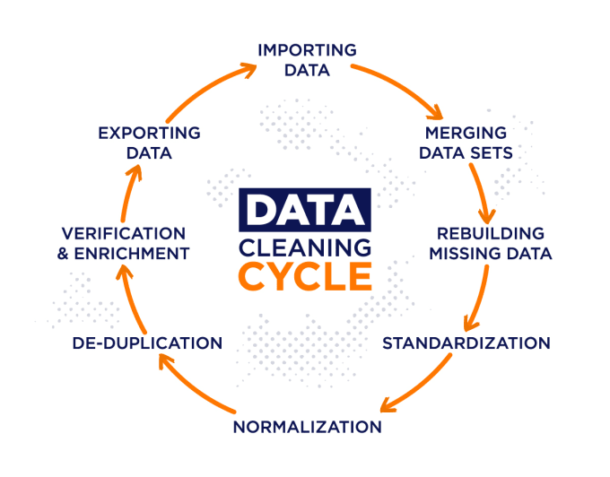

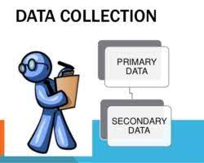




Project Architecture
Data Collection Methods
Data Storing
Data Preprocessing
Pre-processed data storage
Users
Load data into this visualization tools

